Slide 1

Parallel Performance Tools: A Short Course
Allen D. Malony
Department of Computer and Information Science

Slide 2
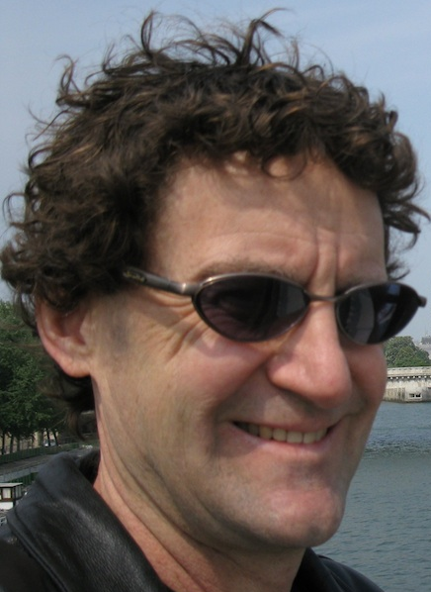
Who am I?
Professor, Department of Computer and Information Science Director, Neuroinformatics Center University of Oregon
Ph.D., University of Illinois, Urbana-Champaign (1991)
Fulbright Research Scholar
Utrech University, The Netherlands (1991)
University of Vienna, Austria (1998)
National Science Foundation Young Investigator (1994)
Alexander von Humboldt Research Award (2002)
Research interests
Parallel performance analysis, scalable parallel software and tools, high-performance computing
Computational science, neuroinformatics

Slide 3
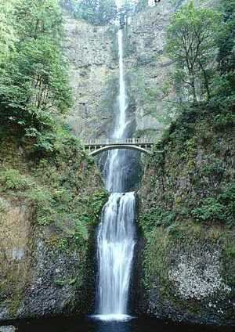

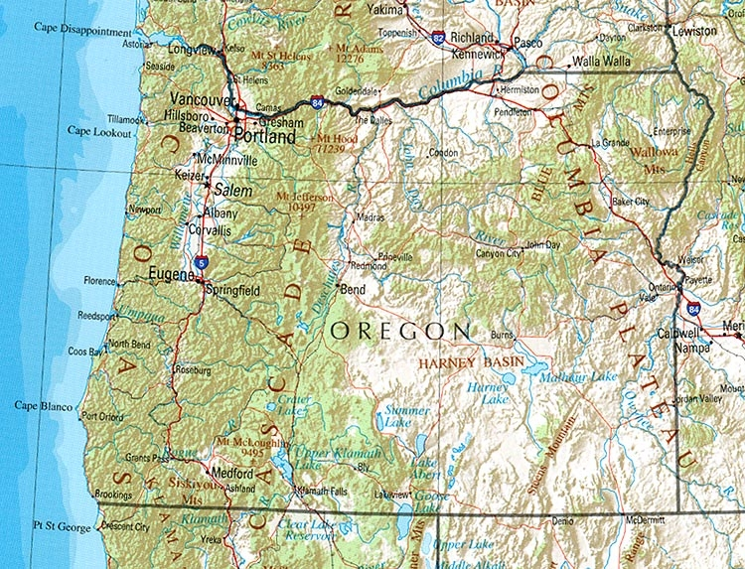

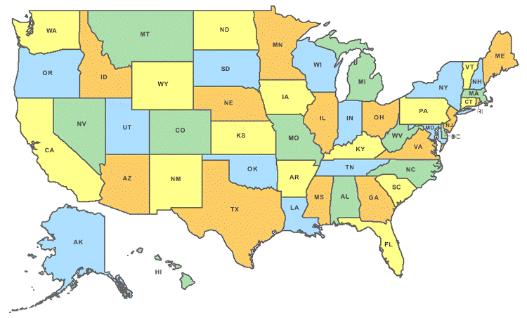

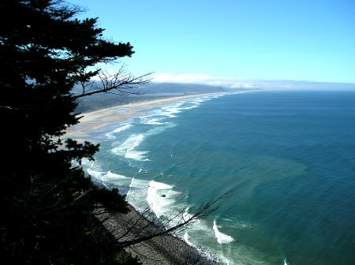
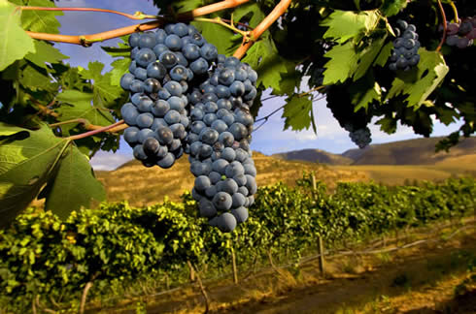
Where do I come from?
Eugene
Oregon
USA

Slide 4
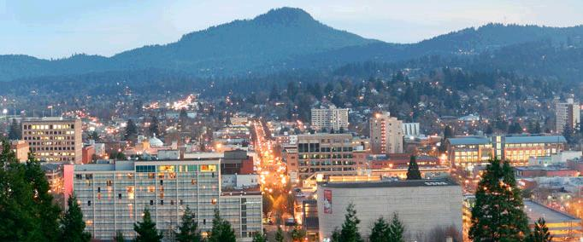
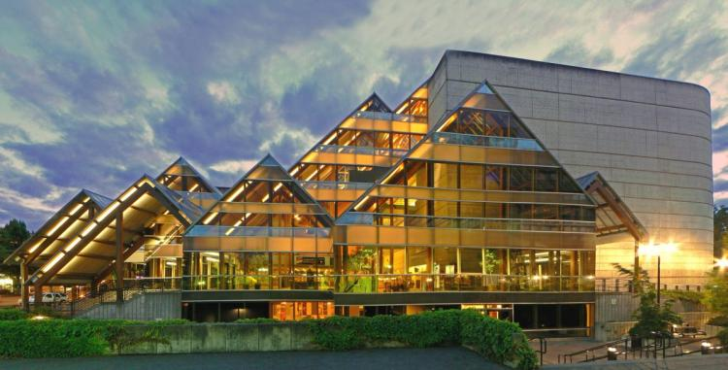


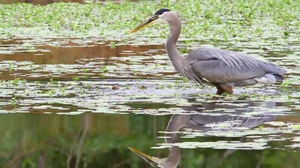


What is Eugene like?

Slide 5
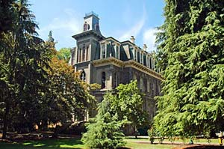
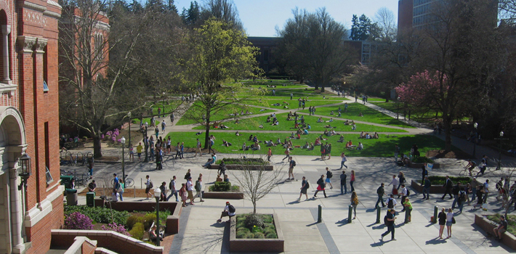
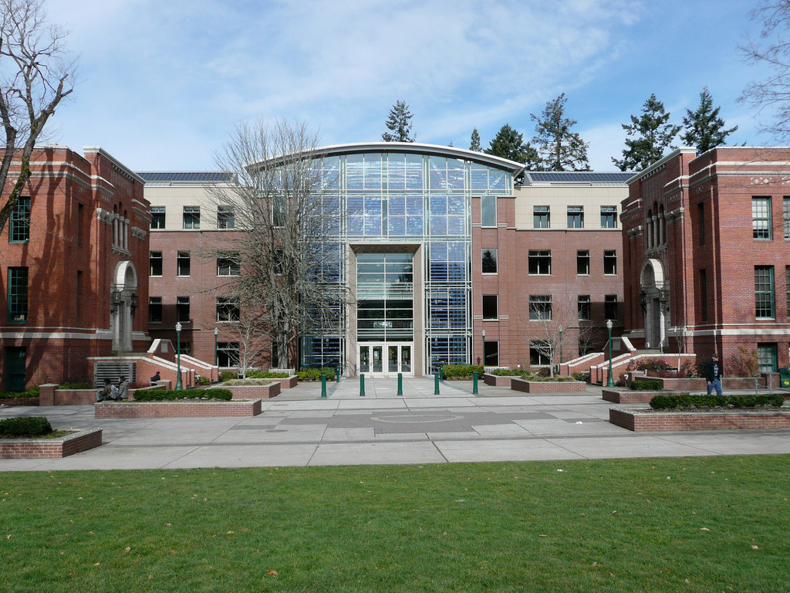
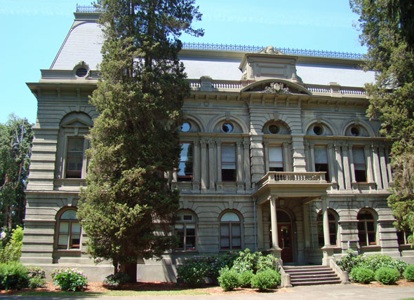
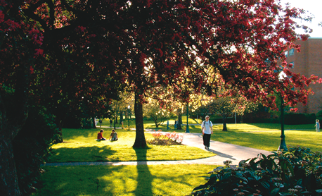


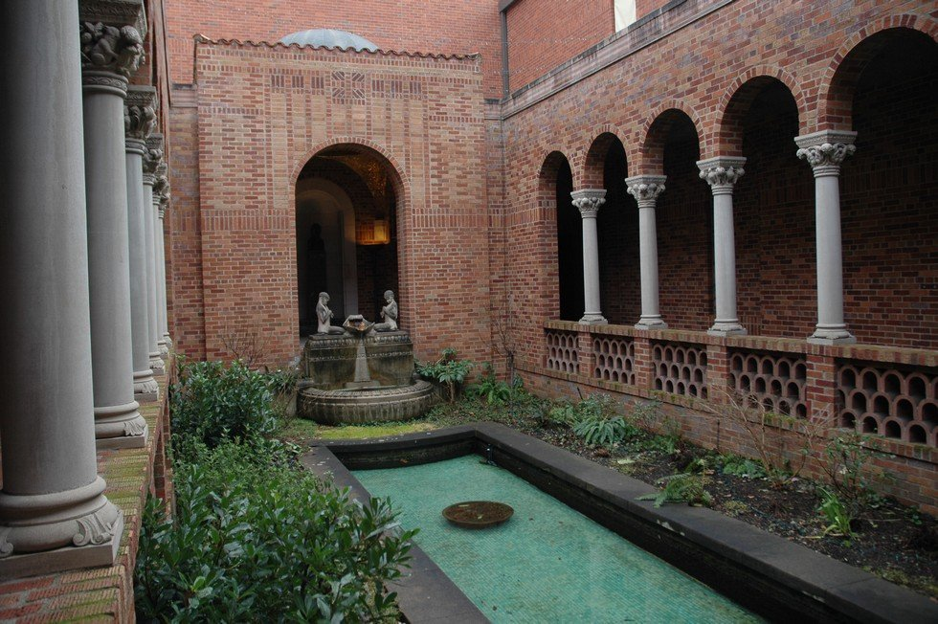
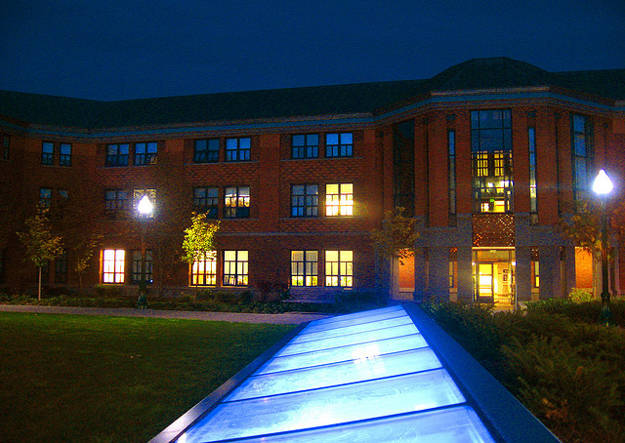
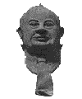

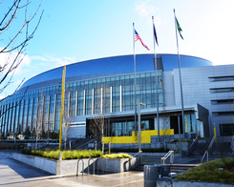
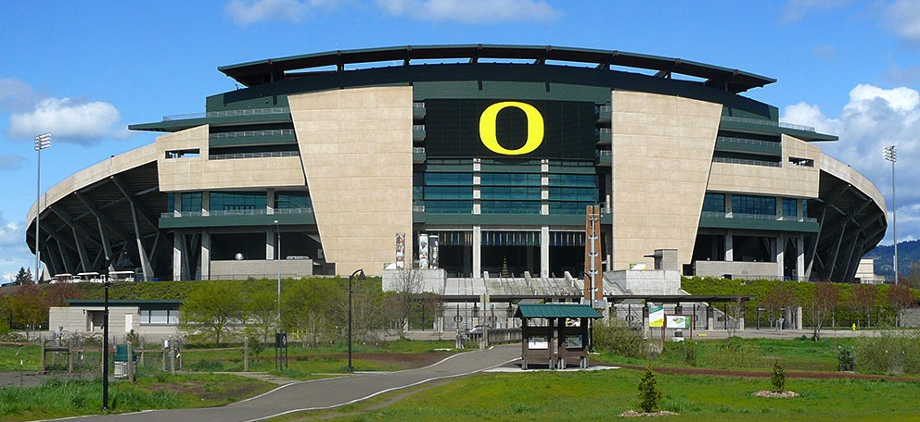
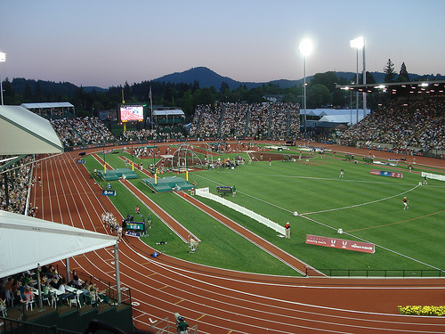
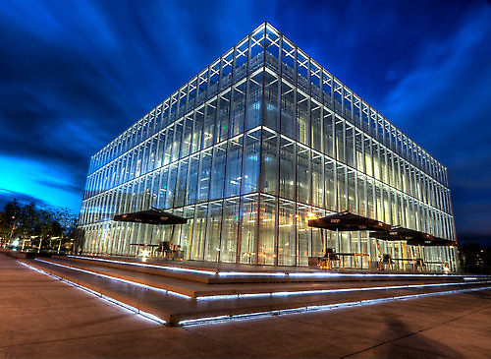
University of Oregon

Slide 6
Short Course Outline
Lecture 1: Introduction and Fundamentals
Lecture 2: Methodology
Lecture 3: Tools Technology
Lecture 4: Tools Landscape – Part 1
Lecture 5: Tools Landscape – Part 2
Lecture 6: TAU Performance System
Lecture 7: TAU Applications
Lecture 8: Advances in TAU
Lecture 9: Future Directions
Tuesday
Wednesday
Thursday

Slide 7
Acknowledgements
I would like to thank the following US and international colleagues for their contributions to the content presented in the short course
Kevin Huck, Sameer Shende, University of Oregon
Martin Schulz, Lawrence Livermore National Laboratory
Valerie Taylor, Texas A&M University
Jeff Hollingsworth, University of Maryland
Dan Terpstra, University of Tennessee, Knoxville
Jeff Vetter, Oak Ridge National Laboratory
Bart Miller, University of Wisconsin, Madison
Shirley Moore, University of Texas, El Paso
Laura Carrington, San Diego Supercomputing Center
Felix Wolf, RWTHAachen University, Germany
Bernd Mohr, Juelich Research Center, Germany
Jesus Lebarta, Judit Gimenez, Barcelona Supercomputing Center, Spain
Wolfgang Nagel, Technical University, Dresden, Germany

